Slide 1
Introductory General Chemistry
Chemistry 3A
Experiment 12b
Determination of Citric Acid in Soda
Mitch Halloran

Slide 2
Introduction
Titrations are used to determine quantitatively amounts (as concentrations) of a substance in solution
This experiment will use sodium hydroxide (NaOH) as a titrant to determine the concentration of citric acid in a lemon-lime soft drink in Part II of the experiment
But in Part I of the experiment, it will be necessary to standardize the titrant (i.e. determine its exact concentration) by titrating a known mass of oxalic acid dissolved in aqueous solution with the NaOH.

Slide 3
Background
Acids and bases react with each other to neutralize each other
First some key elements to set up the explanation:
HX is an acid. The acid can be strong or weak, but the H produces an H⁺ (proton) in solution, and X– is the conjugate base. The acid might HCl (strong) or CH₃COOH [acetic acid] (weak). These produce one H⁺ (proton) in solution
MOH or MOR is a base, where M is cation, like metal cation (Na⁺, K⁺, Ca²⁺, Mg²⁺, and many more). The base can be strong or weak, but the OH part produces OH– (hydroxyl ion) which is a strong base in solution. Or the OR part can produce OR– which is a weak base in solution. An example of MOH is NaOH or KOH. An example of MOR is CH₃COONa (sodium acetate) or HCOOK (potassium formate)

Slide 4
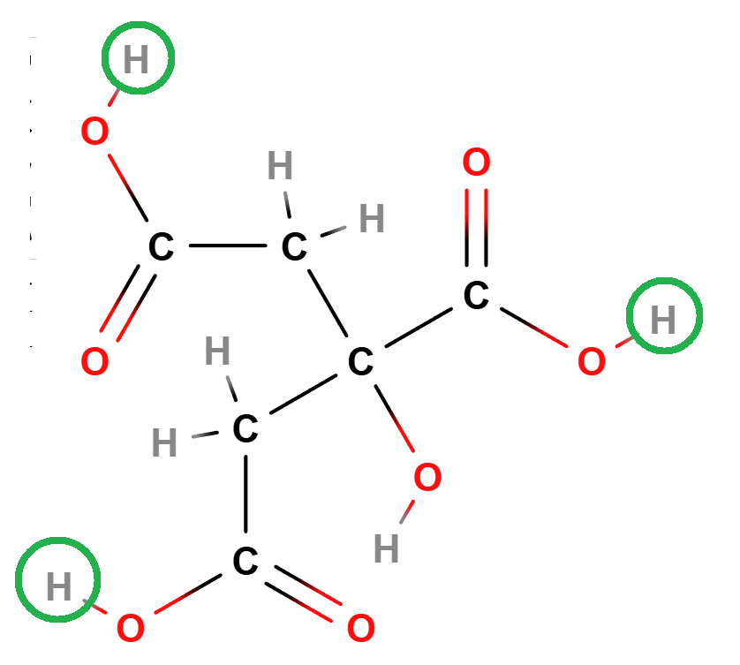

Background
In neutralizing each other, the pattern is always the same, whether weak or strong acids react with weak or strong bases
acid + base → water + salt
HX + MOH → H₂O + MX
HX + MOR → H₂O + XOR
Titration will make use of strong base NaOH to quantitate the weak acid citric acid (see structure)
Citric acid has 3 acidic protons (circled green) so it will take 3 molecules NaOH to neutralize 1 molecule of citric acid
Reaction ratio: $\frac{1 mole citric acid}{3 moles NaOH}$

Slide 5
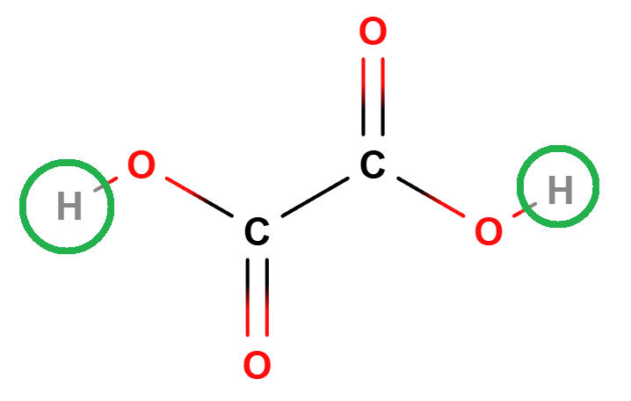
Background
In order to titrate with NaOH to determine citric acid, the concentration of the titrant NaOH must be known with precision. And it is not known except it is ~0.1 M, which means “approximately 0.1 molar” (moles per liter)
So it is necessary first to standardize the titrant NaOH (it means, determine its exact concentration) using an analyte of known mass dissolved in water. This analyte is oxalic acid (HOOC-COOH). Oxalic acid is a weak acid like citric acid, but it has two acid groups and not three. So it takes two moles NaOH to neutralize oxalic acid and reach equivalence point. At the equivalence point, pH indicator phenolphthalein will go from colorless to pink

Slide 6
Procedure
The titrant is placed in a buret and the analyte to be titrated will be placed in an Erlenmeyer flask
Small volumes (aliquots) of titrant will be delivered from a buret controlling its stopcock to deliver a precise total volume that is the equivalence point of the neutralization of all the protons of the acid with the hydroxyl of the base.
It will be necessary to drop titrant directly in the solution (not along walls of flask) and swirl with each drop or aliquot to ensure mixing and persistence of indicator color.

Slide 7
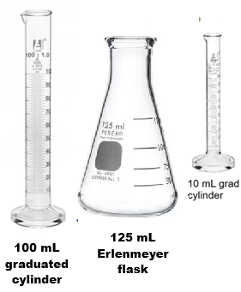
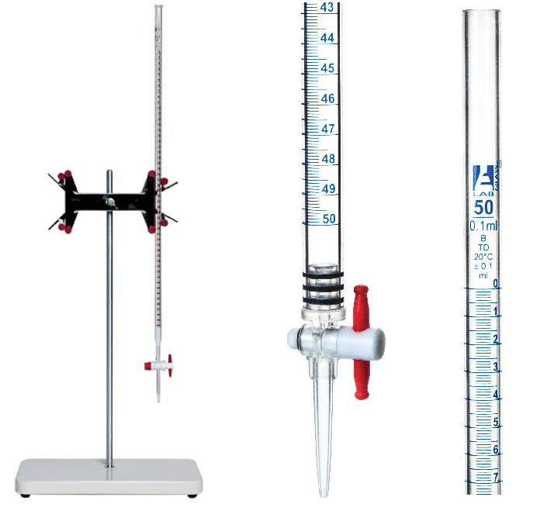
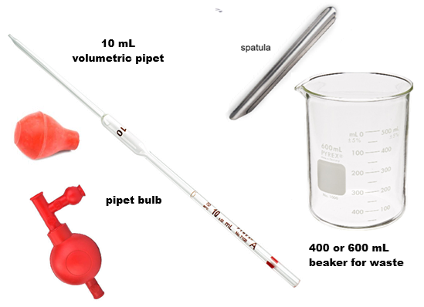
Equipment You Will Use

Slide 8
Consumables You Will Use

Slide 9
Procedure
This experiment has two parts
In part 1, you will do at least 3 trials of standardizing the concentration of a NaOH solution using oxalic acid dihydrate. This involves getting a mass of oxalic acid on the balance, dissolving it, and neutralizing it with a color pH indicator to its endpoint
In part 2, you will use the NaOH solution to neutralize another acid, citric acid, determining the volume you used, to determine the concentration of the acid in a soft drink. This too will be done in 3 trials
In each trial of all parts, it is necessary to achieve the proper color of the indicator to be accurate

Slide 10
Procedure
Preparing the buret
Rinse the buret with 5 mL DI water three times (turn buret on side and rotate it). Collect the rinse in a large waste beaker.
Repeat rinsing but with 5 mL of the titrant NaOH solution
Clamp the buret to the stand and with the waste beaker under it and stopcock open, add several mL to buret. As it flows, close stopcock. Ensure flow has filled buret tip

Slide 11
Procedure
Part I-Standardization
Fill buret with ~0.1 M NaOH titrant between the 0 and 3 mL mark
Record initial buret reading to correct precision: if the smallest division mark is 0.1 mL, then the precision should be ±0.01 mL
Oxalic acid
Put glassine weigh paper on balance and tare (zero)
Spoon out between 0.1000 and 0.1200 g oxalic acid dihydrate and record mass
Transfer the acid completely without spilling into flask
Add about 10 mL DI-water in 10 mL graduated cylinder to the flask with acid, swirl to dissolve
Add 2-3 drops phenolphthalein to flask

Slide 12
Procedure
Part I-Standardization
Place piece of white paper under flask to observe any color change
Swirl flask and quickly add 10 mL NaOH from buret
Drop-by-drop titration
The stopcock will be turned only to permit drop by drop addition of NaOH. Turn the stopcock on and off in controlled manner to dispense drops as necessary. As flask is swirled with each drop, look for pink color to appear. With each drop, the color may disappear more slowly. As the endpoint is reached, a very faint pink color will persist in solution.
The best control is to quickly rotate stopcock by 180°, or to form a tiny drop in the tip, and touch tip to inside of flask wall

Slide 13
Procedure
Part I-Standardization
Record the final buret reading
Repeat the standardization steps for additional trials, and especially if over-titrations occurred (the pink is too intense/bright)

Slide 14
Procedure
Part II-Determination
Get about 40 mL of soft drink in small beaker. Note it will have lost its carbonation.
Use a 10 mL volumetric pipet to transfer precisely 10.00 mL to clean, well-rinsed Erlenmeyer flask.
Add 2-3 gtt phenolphthalein indicator to flask
Fill the buret to between 0-3 mL marks with the ~0.1 M NaOH solution.
Titrate the soda as for the standardization procedure
Record final volume
Repeat the number of trials.

Slide 15
Clean Up
Pour waste solutions in the aqueous solution carboy located in the fume hood (usually placed near door)
Clean up other equipment as done previously in the lab

Slide 16
Example Data Analysis
Part I-Standardization
Calculate the moles of NaOH reacting with the known mass of oxalic acid. Note that 2 mol NaOH reacts with 1 mol oxalic acid
Convert the NaOH titrant volume from mL to L
Calculate the concentration (molarity) of NaOH from the standardization
Part II-Determination
Calculate the liters NaOH (from mL) titrant used for the citric acid
Calculate the mole citric acid using mean NaOH concentration and volume NaOH. 3 mol NaOH reacts with 1 mol citric acid

Slide 17
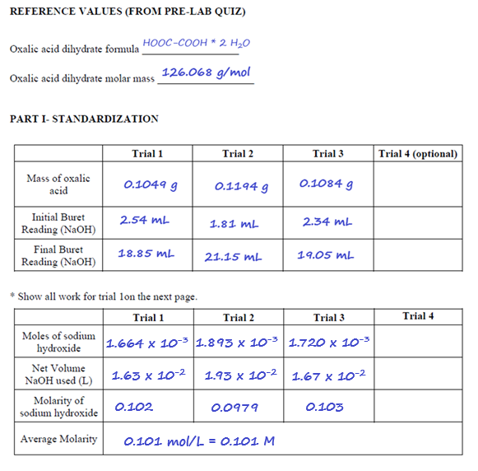
Example Data Analysis

Slide 18
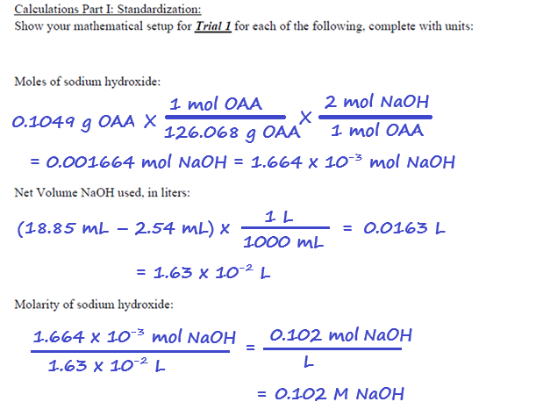
Example Data Analysis

Slide 19
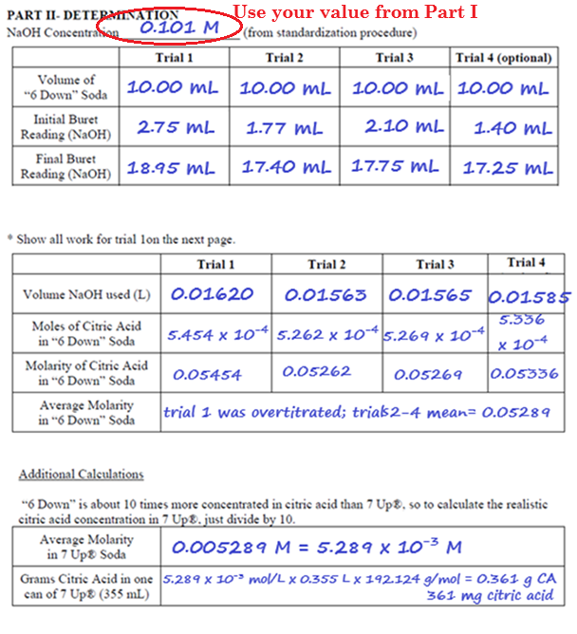
Example Data Analysis

Slide 20
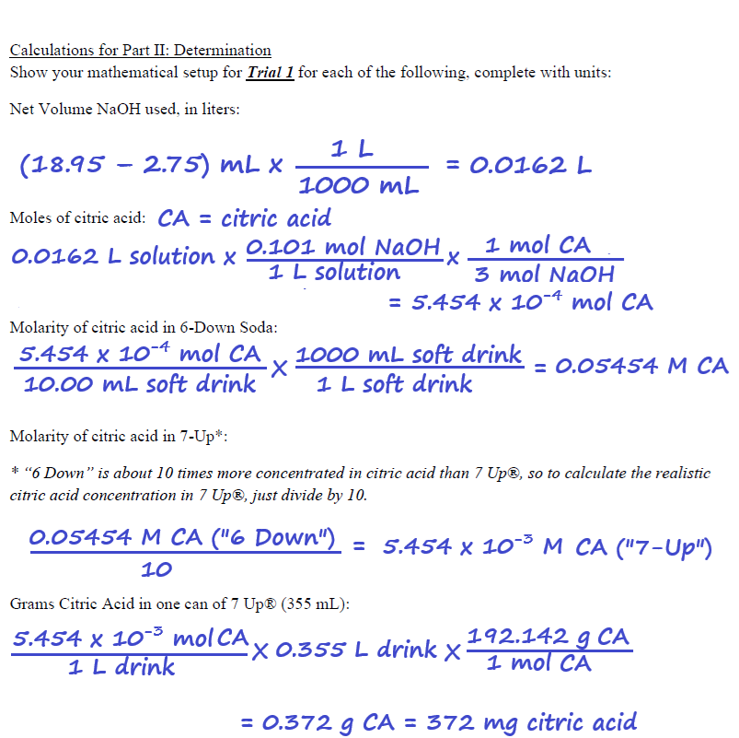
Example Data Analysis

